Slide 1
PIZZA SALES PERFORMANCE SUMMARY
OLOTU DAMILARE ISAAC
3-12-2025

Slide 2
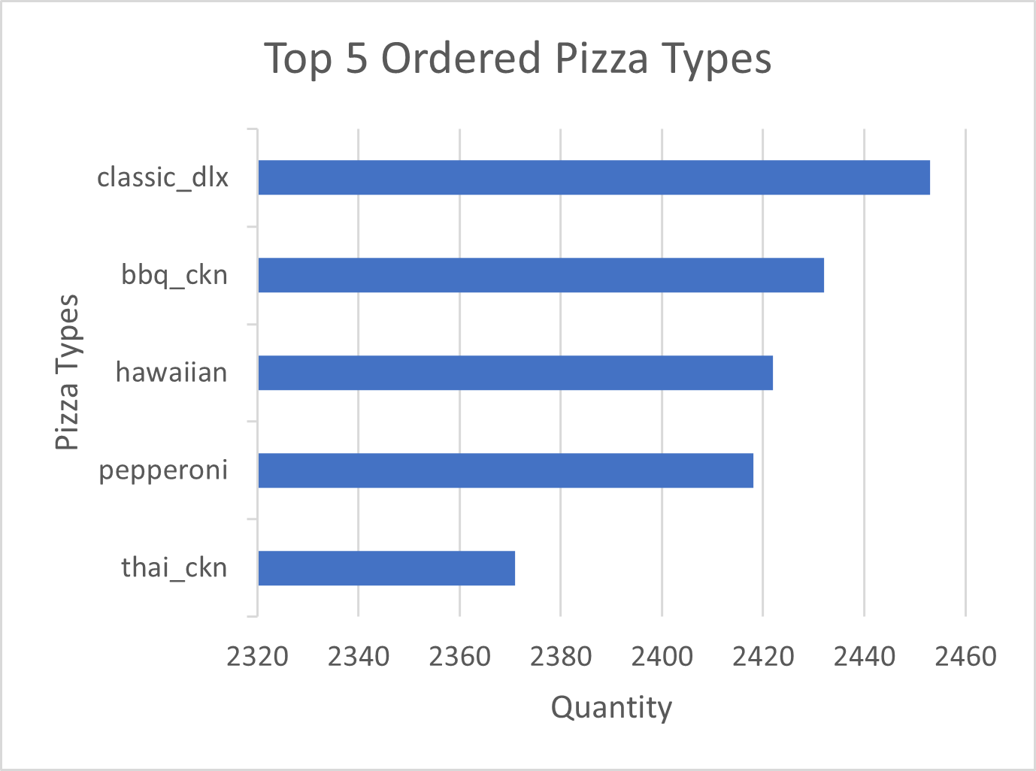
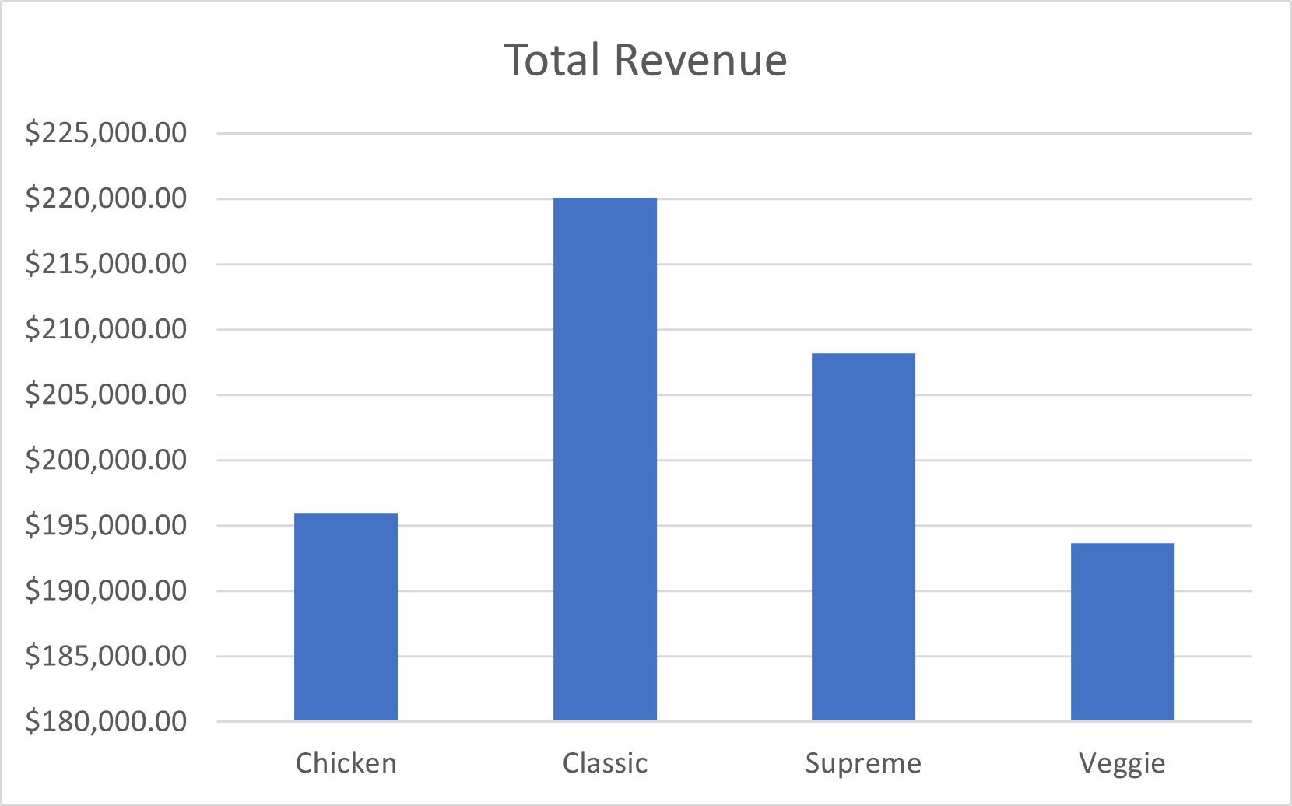
KEY METRICS
Total revenue – $817,860.05
Total orders – 21350
Average order value – $38.3073
Total quantity sold – 50k
Top pizza type – Big meat pizza (Small)
INSIGHTS
The top 5 pizzas contributed 24.19% (12,096) of total sales (50,000)
Most frequent pizza size ordered was the small size
Highest revenue month – JULY ( there was 1935 orders with revenue of $72.56k)
SUMMARY
Overall, pizza sales showed strong performance driven by the consistent orders of the top 5 pizza types.

